Slide 1
Cyclistic Case Study Report
Ahmed Amin
Junior data analyst
02/05/2023

Slide 2
Content
Introduction
Goal
Overview of the two user types
Exploring the behaviors of casual users
Recommendations for Data-Driven Decision Making

Slide 3
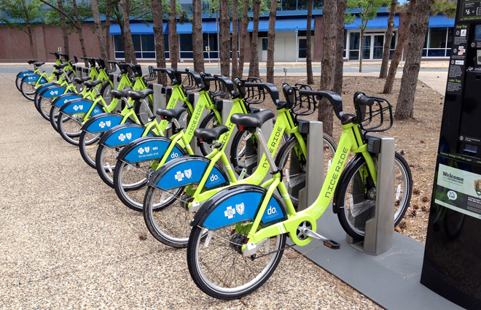
Introduction
Cyclistic is a bike-share program launched in 2016
The program has since grown to a fleet of 5,824 geotracked bicycles
The bikes are locked into a network of 692 stations across Chicago
The bikes can be unlocked from one station and returned to any other station in the system anytime.
https://www.portlandpedalpower.com/blog/2014/03/bike-share-alternatives-developing-the-future-of-cycling/

Slide 4
Introduction
Cyclistic’s marketing strategy relied on building general awareness and appealing to broad consumer segments
Flexibility of pricing plans was a key aspect of the marketing strategy
Three pricing plans offered: single-ride passes, full-day passes, and annual memberships
Casual riders are customers who purchase single-ride or full-day passes
Customers who purchase annual memberships are referred to as Cyclistic members

Slide 5
Introduction
Cyclistic's finance analysts concluded that annual members are more profitable than casual riders
Maximizing the number of annual members is seen as key to future growth
Instead of targeting all new customers, focus on converting casual riders into members
Casual riders are already aware of the program and have chosen Cyclistic for their mobility needs
Marketing campaign should aim to convert casual riders into annual members

Slide 6
Goal
Converting riders into annual members
Better understand how annual members and casual riders differ
Why casual riders would buy a membership
How digital media could affect their marketing tactics

Slide 7
Overview of the two user types
Total number member are nearly double casual users
Average time usage for member around 13 minutes per month
Average usage for casual around 28 minutes per month

Slide 8
Overview of the two user types
Most Member user used the services on Thursday
Most Casual user used the services on Saturday
1 = Monday
2 = Tuesday
3 = Wednesday
4 = Thursday
5 = Friday
6 = Saturday
7 = Sunday
Notes:
Y axis vs X axis
Histogram

Slide 9
Overview of the two user types
Maximum time using from Dec to April was nearly similar around 24 hours
From May until Oct member are around 1 hour but causal almost 20 hours

Slide 10
Overview of the two user types
The number of member classic bike user are nearly double number of casual user
The average number of member user to classic bike was around 100,000 user per month
The average number of casual user to classic bike was around 50000 user per month

Slide 11
Overview of the two user types
The average number of member user to electric bike was around 100,000 user per month
The average number of casual user to electric bike was around 75000 user per month
The number of casual electric user in July exceed number of member user

Slide 12
Exploring the behaviors of casual users
The number of rides of the electric bike is nearly double the classic bike

Slide 13
Exploring the behaviors of casual users
Most of the causal users are using the services on Weekend

Slide 14
Recommendations for Data-Driven Decision Making
The best time for offers are on weekend
Develop promotions for electric bikes: offer discounts, bundle deals, and other incentives to encourage purchases
Utilize digital marketing channels to promote offers especially during summer: use email marketing, social media advertising, and other digital channels to reach a wider audience
Track sales and customer feedback to determine if the offers were effective and make improvements for future promotions

